Slide 1
ITCS / DSBA 6162
Action Rules Implementation
Nikhil Jadhav
Phyllis Jones
Saketh Kumar Kappala
Bala Guna Teja Karlapudi
at Charlotte

Slide 2
Agenda
Definitions
Example
Our Approach
Analysis/Results
Resources

Slide 3
Definitions
Knowledge Discovery in Databases (KDD)- The nontrivial process of identifying valid, novel, potentially useful, and ultimately understandable patterns in data. 1
Action Rules - logical terms describing knowledge about possible actions associated with objects which is hidden in a decision system. A rule can be defined as:
r = [a1,1 ∧ a2,1 ∧ ... ∧ ap,1 ] ∧ [b1,1 ∧ b2,1 ∧ ... ∧ bq,1] → d1
stable part flexible part
A rule is actionable if user can do an action to his/her advantage based on this rule.₂
Stable attributes – attribute’s value does not change
Flexible attributes – attribute’s value can change

Slide 4

Definitions
Let us assume we have a decision system $S=\left(U, A_{1} ∪ A_{2} ∪ \left\{d\right\}\right)$ such that:
$d ∉A_{1}∪ A_{2}$ where $d$ is decision attribute
$A_{1}$ is set of stable attributes and $\left\{a_{1}, a_{2}, a_{3},…,a_{n}\right\}∈ A_{1}$ and $a_{[i,j]}$ denotes value of attribute $a_{i}$
$A_{2} ∪\{d\}$ is set of flexible attributes and $\left\{b_{1}, b_{2}, b_{3},…,b_{n}\right\}∈A_{2}$ and $b_{[i,j]}$ denotes value of attribute $b_{i}$
Also, assume that $d_{1}∈ V_{d}$ and $x∈U$ and $x$ is $d_{1}$’s object if $d\left(x\right)= d_{1}$.
We then have the following classification rule extracted from decision system S using LERS algorithm:
$$r=[\left[a_{\left[1,1\right]}∧a_{\left[2,1\right]}∧…∧a_{\left[p,1\right]}\right]∧\left[b_{\left[1,1\right]}∧b_{\left[2,1\right]}∧…∧b_{\left[q,1\right]}\right]→d_{1}]$$

Slide 5

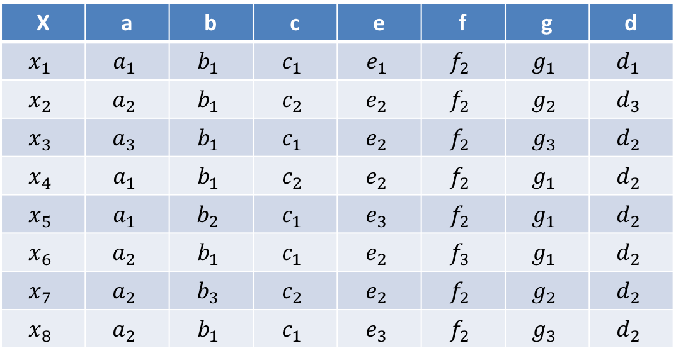
Example of ARAS algorithm for discovering action rules
Consider the following decision system, S
X | a | b | c | e | f | g | d
$$x_{1}$$ | $$a_{1}$$ | $$b_{1}$$ | $$c_{1}$$ | $$e_{1}$$ | $$f_{2}$$ | $$g_{1}$$ | $$d_{1}$$
$$x_{2}$$ | $$a_{2}$$ | $$b_{1}$$ | $$c_{2}$$ | $$e_{2}$$ | $$f_{2}$$ | $$g_{2}$$ | $$d_{3}$$
$$x_{3}$$ | $$a_{3}$$ | $$b_{1}$$ | $$c_{1}$$ | $$e_{2}$$ | $$f_{2}$$ | $$g_{3}$$ | $$d_{2}$$
$$x_{4}$$ | $$a_{1}$$ | $$b_{1}$$ | $$c_{2}$$ | $$e_{2}$$ | $$f_{2}$$ | $$g_{1}$$ | $$d_{2}$$
$$x_{5}$$ | $$a_{1}$$ | $$b_{2}$$ | $$c_{1}$$ | $$e_{3}$$ | $$f_{2}$$ | $$g_{1}$$ | $$d_{2}$$
$$x_{6}$$ | $$a_{2}$$ | $$b_{1}$$ | $$c_{1}$$ | $$e_{2}$$ | $$f_{3}$$ | $$g_{1}$$ | $$d_{2}$$
$$x_{7}$$ | $$a_{2}$$ | $$b_{3}$$ | $$c_{2}$$ | $$e_{2}$$ | $$f_{2}$$ | $$g_{2}$$ | $$d_{2}$$
$$x_{8}$$ | $$a_{2}$$ | $$b_{1}$$ | $$c_{1}$$ | $$e_{3}$$ | $$f_{2}$$ | $$g_{3}$$ | $$d_{2}$$
We have to re-classify objects in given decision system from $d_{2}$ to $d_{1}$
Stable attributes
Flexible attributes
Decision attribute

Slide 6

Example of ARAS algorithm for discovering action rules
Step 1: Using LERS algorithm find all possible rules implying $→d_{1}$on right hand side. (If we are re-classifying $d_{2}$ to $d_{3}$ we’ll get rules implying $→d_{3}$ on right hand side).
$$r1=[b_{1}∧c_{1}∧f_{2}∧g_{1}]→d_{1}$$
Step 2: For each rule action rule schema associated with $r_{1}$ and $r_{2}$ and reclassification task ${(d, d}_{2}→d_{1})$ are:
${r1}_{[d_{2}→d_{1}]}=\left[b_{1}∧c_{1}∧\left(f,→f_{2}\right)∧\left(g,→g_{1}\right)\right]→\left(d,d_{2}→d_{1}\right)$
where${ b}_{1}∧c_{1}$ - stable and $f_{2}∧g_{2}$ - flexible hence, represented $\left(f,→f_{2}\right)$ which means change to $f_{2}$ from anything.
Step 3: Check support which is shown as,
$$U_{[r1,d_{2}]}=Sup\left({r1}_{\left[d_{2}→d_{1}\right]}\right)=\left\{x_{3},x_{6},x_{8}\right\}$$
Step 4: Take stable header values from ${r1}_{[d_{2}→d_{1}]}$and combine it with remaining attribute values. And check if they are subset of $U_{\left[r1,d_{2}\right]}.$ If yes, mark them.

Slide 7

Example of ARAS algorithm for discovering action rules
${\left[b_{1}∧c_{1}∧a_{1}\right]}^{∗}=\{x_{1}\}⊈U_{[r1,d_{2}]}$ - Not Marked
${\left[b_{1}∧c_{1}∧a_{2}\right]}^{∗}=\{x_{6},x_{8}\}⊆U_{[r1,d_{2}]}$ - Marked
${\left[b_{1}∧c_{1}∧a_{3}\right]}^{∗}=\left\{x_{3}\right\}⊆U_{\left[r1,d_{2}\right]}$ - Marked
${\left[b_{1}∧c_{1}∧f_{3}\right]}^{∗}=\left\{x_{6}\right\}⊆U_{\left[r1,d_{2}\right]}$ - Marked
${\left[b_{1}∧c_{1}∧g_{3}\right]}^{∗}=\left\{x_{3,}x_{8}\right\}⊆U_{\left[r1,d_{2}\right]}$ - Marked
Using these Marked values we generate action rules using ${r1}_{[d_{2}→d_{1}]}$
$$\left[b_{1}∧c_{1}∧a_{2}∧\left(f,→f_{2}\right)∧\left(g,→g_{1}\right)\right]→\left(d,d_{2}→d_{1}\right)$$
$$\left[b_{1}∧c_{1}∧a_{3}∧\left(f,→f_{2}\right)∧\left(g,→g_{1}\right)\right]→\left(d,d_{2}→d_{1}\right)$$
$$\left[b_{1}∧c_{1}∧\left(f,f_{3}→f_{2}\right)∧\left(g,→g_{1}\right)\right] →\left(d,d_{2}→d_{1}\right)$$
$$\left[b_{1}∧c_{1}∧\left(f,→f_{2}\right)∧\left(g,g_{3}→g_{1}\right)\right] →\left(d,d_{2}→d_{1}\right)$$

Slide 8
Our Approach
.data flat file from http://archive.ics.uci.edu/ml/datasets.html in comma or tab delimited format
.data flat file from http://archive.ics.uci.edu/ml/datasets.html in comma or tab delimited format
Place text here.
Generate output file of unique action rules based on user specified support and confidence thresholds, stable and flexible attributes, decision attribute, and desired class

Slide 9
Analysis/Results File #1
Input dataset: LERS Exercise data
Attributes: A, F, G, C
Support and confidence threshold: 3 support and 75% confidence
Decision attribute: C
Decision Value From: 1
Decision Value To: 2
Index: G
Run time: Less than 1 second (approx.)
Rules: Can be found in the Output_1.txt file in the zip

Slide 10
Analysis/Results File #2
Input dataset: Mammographic_data
Attributes: BI-RADS, Age, Shape, Margin, Density, Severity
Support and confidence threshold: 3 support and 75% confidence
Decision attribute: Age
Decision Value From: 30
Decision Value To: 60
Index: Density
Run time: 26 seconds (approx.)
Rules: Can be found in the Output_2.txt file in the zip

Slide 11
Resources
M. Fayyad, Usama & Piatetsky-Shapiro, Gregory & Smyth, Padhraic. (1996). From Data Mining to Knowledge Discovery in Databases. AI Magazine. 17. 37-54. 10.1609/aimag.v17i3.1230.
Liu, B., Hsu, W., Chen, S. (1997). Using general impressions to analyze discovered classification rules, Proceedings of KDD97 Conference, Newport Beach, CA, AAAI Press.
Ras, Zbigniew & Wyrzykowska, Elzbieta & Wasyluk, Hanna. (2007). ARAS: Action Rules Discovery Based on Agglomerative Strategy. 4944. 196-208. 10.1007/978-3-540-68416-9_16.

